Slide 1
LEAVING EGYPT
Journey to the Promised Land

Slide 2
JESUS AS PASSOVER LAMB

Slide 3
Lessons from Egypt…
Reveal God’s Great Power
Illustrates that God keeps His Promises
Show God Delivers His People

Slide 4
Journey to Mt Sinai
Why consecration of firstborn?
How did God lead His people? How does He lead today?
What changed in Egypt?
How did the people respond to this threat?

Slide 5
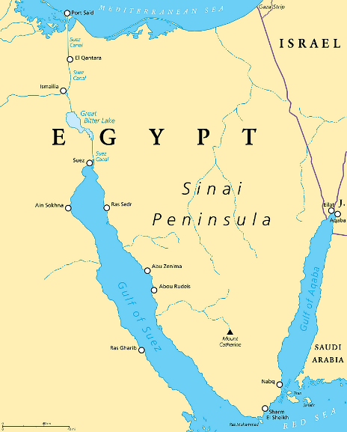

Slide 6
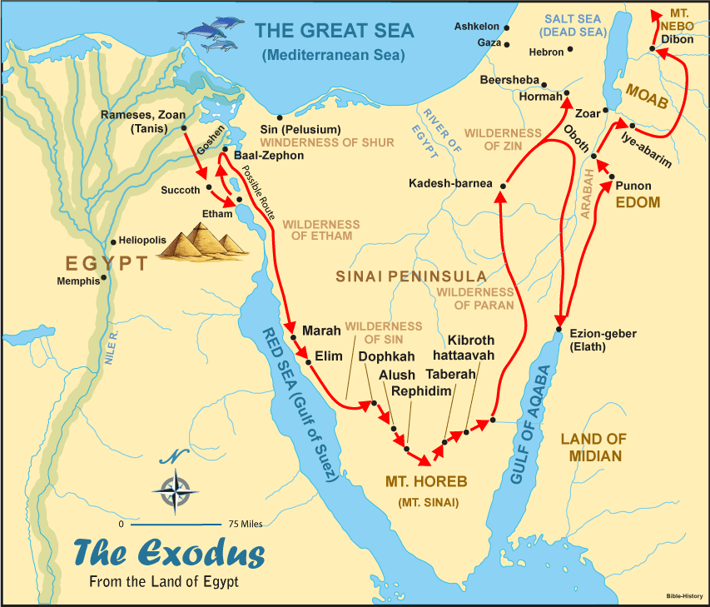

Slide 7
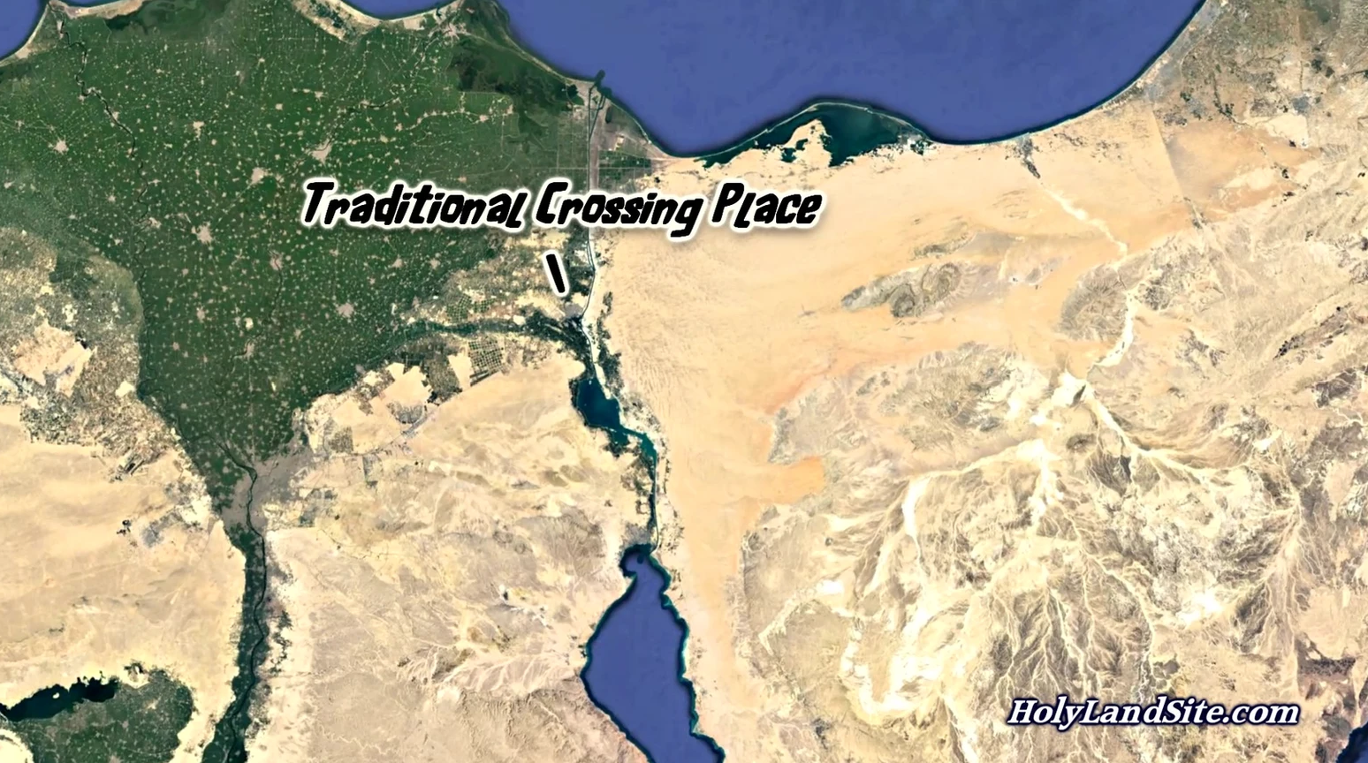
SKEPTICS!!!

Slide 8
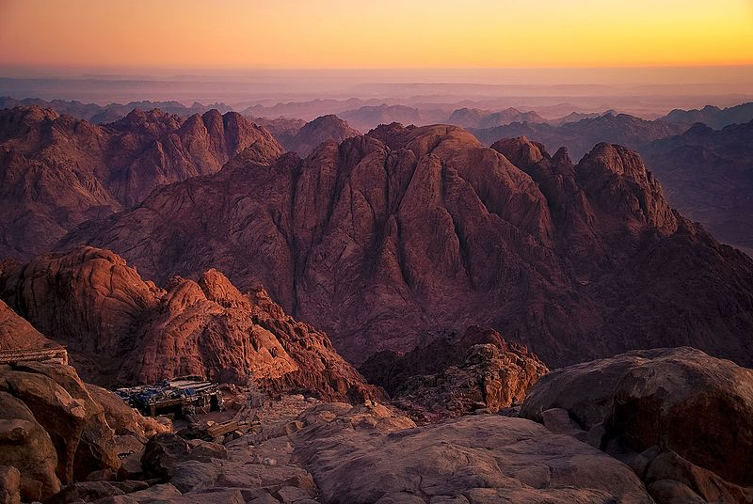
Jabal Mousa

Slide 9
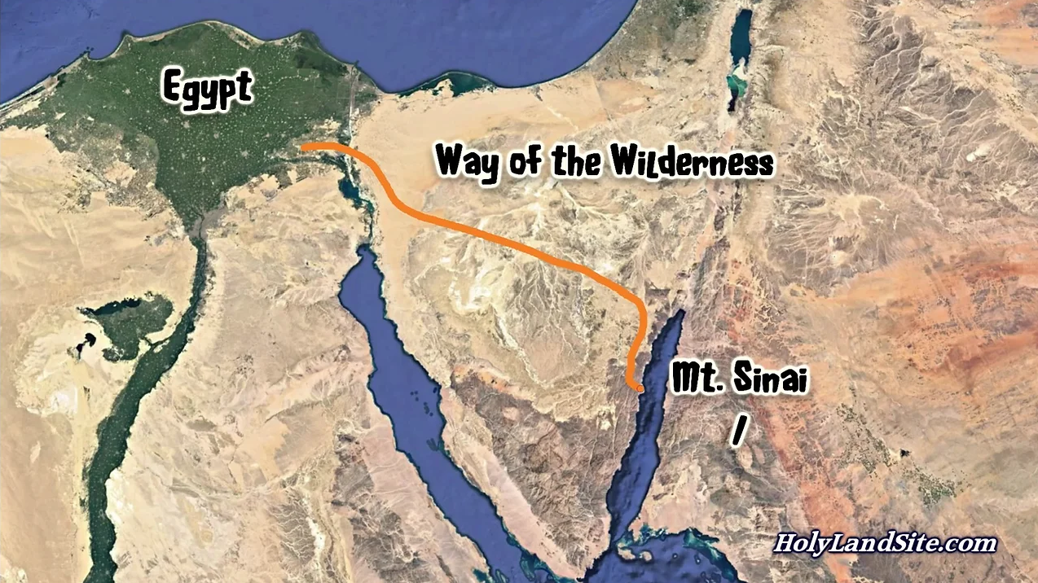
SKEPTICS BEWARE!!!

Slide 10
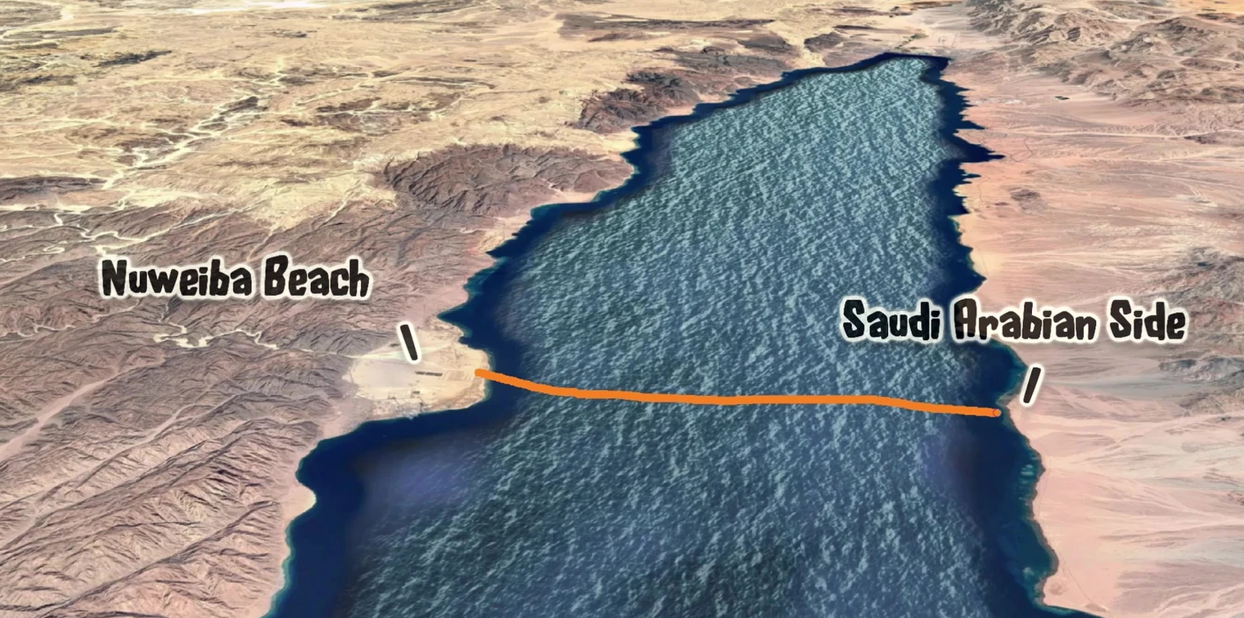
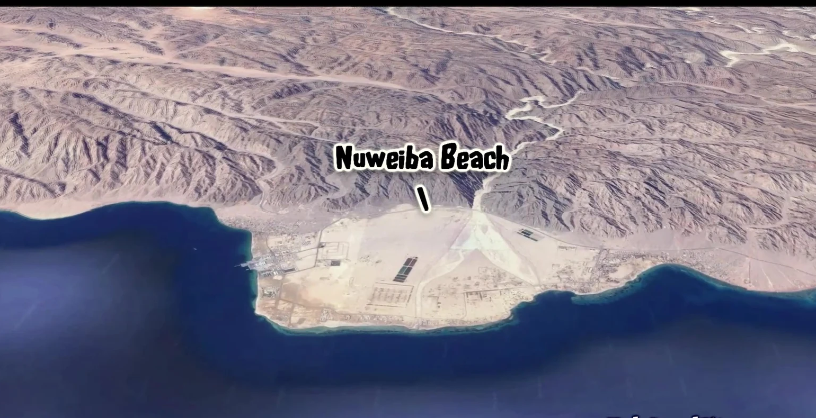
Potential Red Sea Crossing

Slide 11
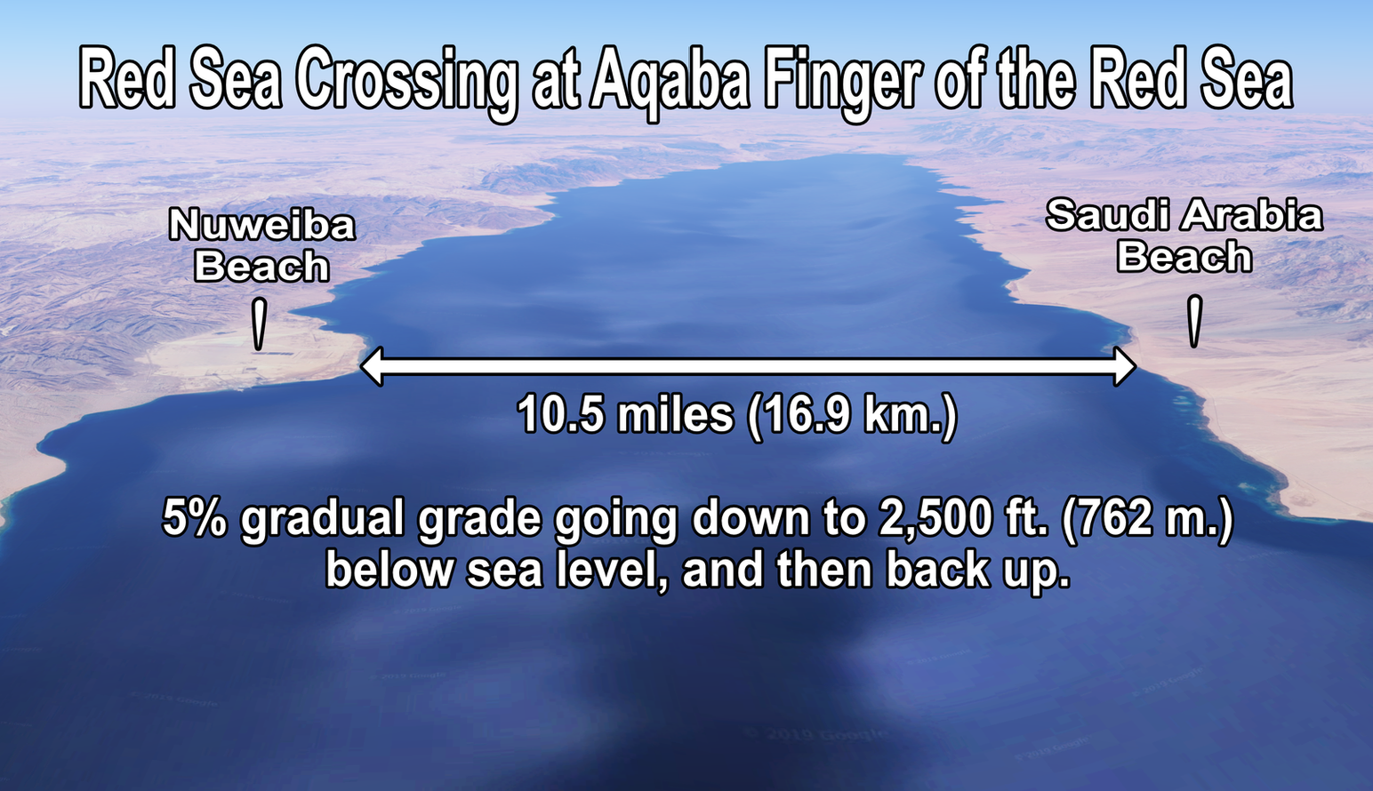
Potential Red Sea Crossing

Slide 12
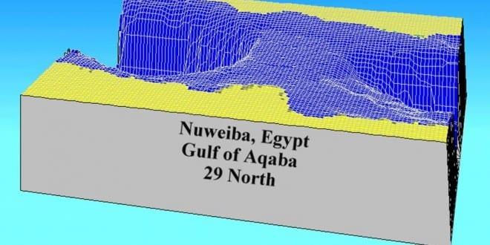
Potential Red Sea Crossing

Slide 13
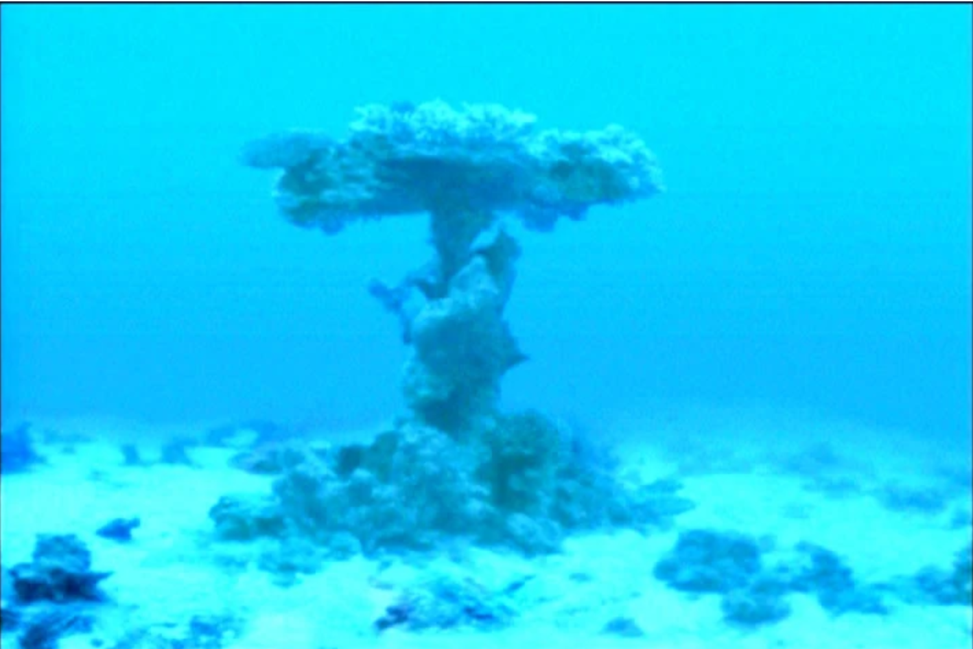
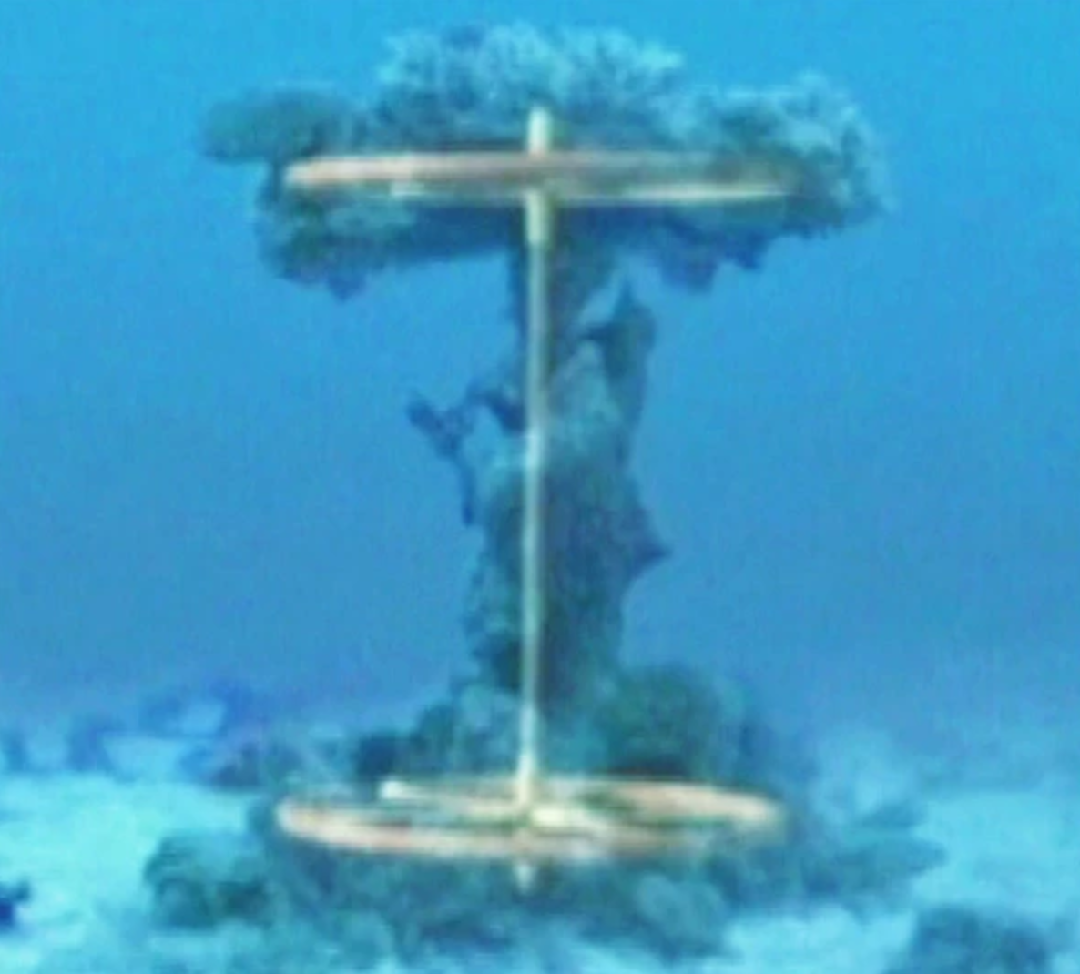
Sea Floor at Nuweiba

Slide 14
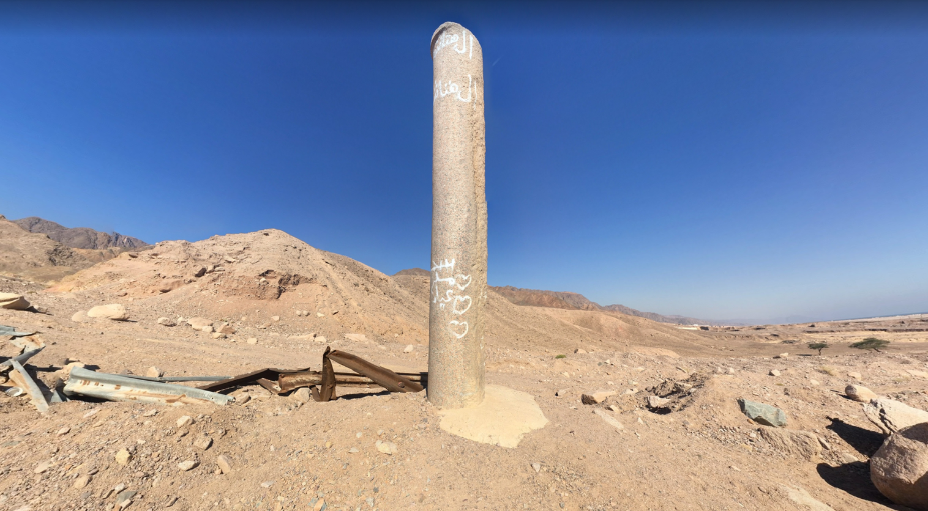
Pillars of Solomon

Slide 15
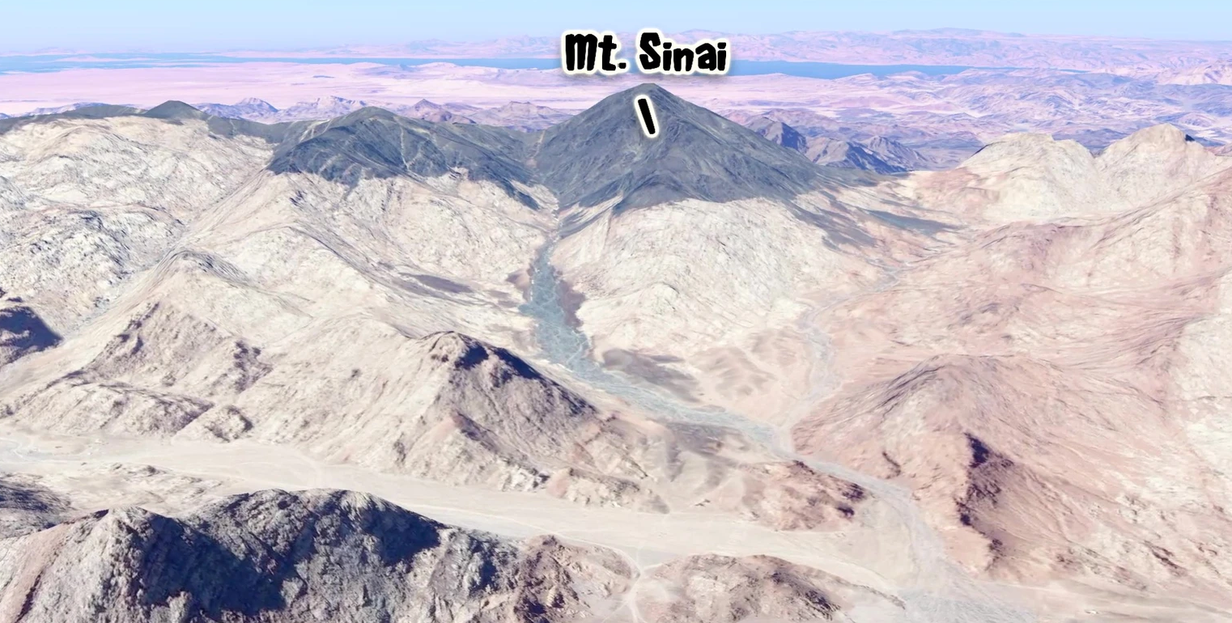
Potential Mt Sinai in Arabia

Slide 16
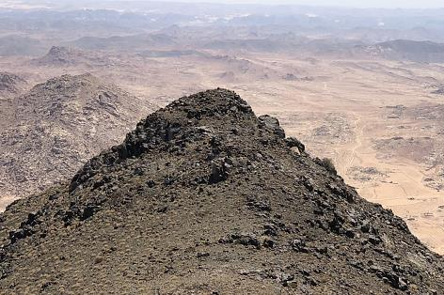
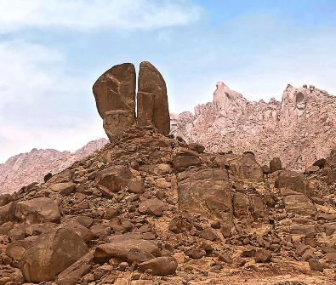
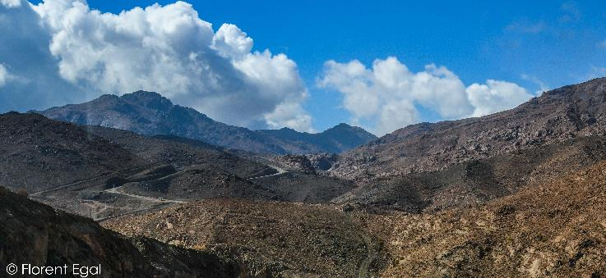
Jabal al-Lawz

Slide 17
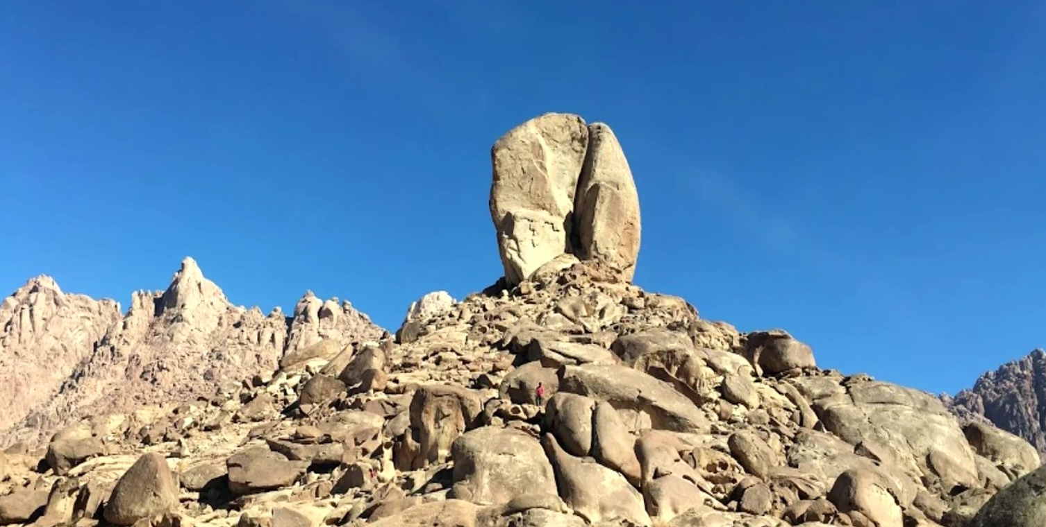
Potential Mt Sinai in Arabia

Slide 18
Thought Questions
When the people become frightened and complain… what did they forget?
“True faith depends on what God says, not what we see or how we feel.” What makes this challenging for us today?
What is Paul suggesting about baptism and the Red Sea in I Cor 10:1-2?

Slide 19
For I do not want you to be unaware, brothers, that our fathers were all under the cloud, and all passed through the sea, and all were baptized into Moses in the cloud and in the sea…
I Corinthians 10:1-2

Slide 20
LEAVING EGYPT
Journey to the Promised Land

