Slide 1
Exodus 5-6 Be Delivered

Slide 2
Chapter 4 What signs does God allow Moses to perform? Why?

Slide 3
Chapter 4 What happens to Moses on his way back to Egypt? Why?

Slide 4
Afterward Moses and Aaron went to Pharaoh and said, “This is what the Lord, the God of Israel, says: ‘Let my people go, so that they may hold a festival to me in the wilderness.’”

Slide 5
Pharaoh said, “Who is the Lord, that I should obey him and let Israel go? I do not know the Lord and I will not let Israel go.”

Slide 6
Then they said, “The God of the Hebrews has met with us. Now let us take a three-day journey into the wilderness to offer sacrifices to the Lord our God, or he may strike us with plagues or with the sword.”

Slide 7
But the king of Egypt said, “Moses and Aaron, why are you taking the people away from their labor? Get back to your work!” Then Pharaoh said, “Look, the people of the land are now numerous, and you are stopping them from working.”

Slide 8
Why did Moses ask for a three-day festival?
What didn’t Pharoah understand about the Lord?
What did God want from both Pharoah and the Israelites?

Slide 9
6 Then the Lord said to Moses, “Now you will see what I will do to Pharaoh: Because of my mighty hand he will let them go; because of my mighty hand he will drive them out of his country.”
² God also said to Moses, “I am the Lord. ³ I appeared to Abraham, to Isaac and to Jacob as God Almighty, but by my name the Lord I did not make myself fully known to them. ⁴ I also established my covenant with them to give them the land of Canaan, where they resided as foreigners. ⁵ Moreover, I have heard the groaning of the Israelites, whom the Egyptians are enslaving, and I have remembered my covenant.
⁶ “Therefore, say to the Israelites: ‘I am the Lord, and I will bring you out from under the yoke of the Egyptians. I will free you from being slaves to them, and I will redeem you with an outstretched arm and with mighty acts of judgment. ⁷ I will take you as my own people, and I will be your God. Then you will know that I am the Lord your God, who brought you out from under the yoke of the Egyptians. ⁸ And I will bring you to the land I swore with uplifted hand to give to Abraham, to Isaac and to Jacob. I will give it to you as a possession. I am the Lord.’”

Slide 10
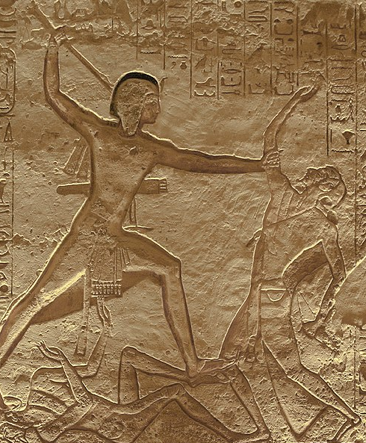
Exodus 6:6: "Therefore, say to the Israelites: 'I am the LORD, and I will bring you out from under the yoke of the Egyptians. I will free you from being slaves to them, and I will redeem you with an outstretched arm and with mighty acts of judgment.'"
Notes:
Battle of Kidesh

Slide 11
Deuteronomy 5:15: "Remember that you were slaves in Egypt and that the LORD your God brought you out of there with a mighty hand and an outstretched arm. Therefore the LORD your God has commanded you to observe the Sabbath day."

Slide 12
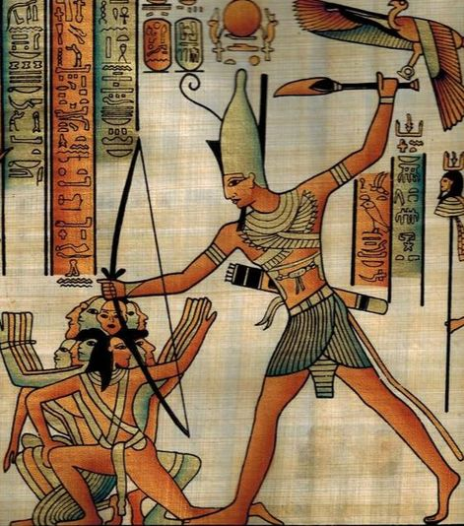
Deuteronomy 7:19: "The great trials which your eyes saw, the signs and the wonders, the mighty hand and the outstretched arm, by which the LORD your God brought you out. So shall the LORD your God do to all the peoples of whom you
Notes:
Ram Smiting the Libyan King

Slide 13
Deuteronomy 26:8: "So the LORD brought us out of Egypt with a mighty hand and an outstretched arm, with great terror and with signs and wonders."

Slide 14
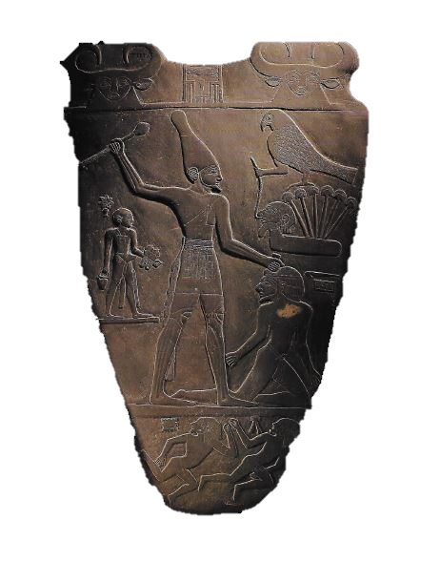
Narmer Palette – 3200 BC
Psalm 136:12: "With a mighty hand and outstretched arm; His love endures forever."

Slide 15
How does the Lord promise to deliver?

Slide 16
How does the Lord promise to deliver?
I Will | Exodus 6:6-7 | New Testament
Bring Out | I will bring you out from under the burdens of the Egyptians. | Luke 4:18-19
Rescue | I will rescue you from their bondage | Galatians 5:1
Redeem | I will redeem you with an outstretched arm and with great judgments | 1 Peter 1:18-19
Take You | I will take you as My people | 1 Peter 2:9-10

